Slide 1
Bootcamp
Cloud Course
Cloud Core TU
19~22 December

Slide 2
Self Introduction
Ankit Purohit
Technology Department
Joined in 2016
HPC Servers verification and OpenStack user

Slide 3
Self Introduction
Name: Yoshifumi Sumida Department: Technology Development Joined Year: 2016 Work: Next PlatForm and OpenStack User Interest: Container, COE

Slide 4
Agenda
•Overview of Cloud
•What is OpenStack?
•OpenStack Deployment tool : DevStack
•Introduction to OpenStack Components
•Manual Installation OpenStack Components
•Handson with OpenStack

Slide 5
Day 1 :
9:30 ~ 10:00 : WiFi Setting, Login to OpenStack
10:00 ~ 11:30 : Introduction to Cloud and OpenStack
11:30 ~ 12:30 : Lunch
12:30 ~ 14:00 : Pre-construction
14:00 ~ 17:00 : OpenStack Component Installation(Keystone, Glance)
17:00 ~ 17:30 : Feedback

Slide 6
Notification
When today lecture finished Please answer the following questionnaire https://questant.jp/q/N4V8CYN6
Notes:
questionnaire

Slide 7
Set up the Environment :
WiFi SSID: TB_CL_Bootcamp2017 PW: Bootcamp2017!!
Moodle Login:
http://bootcamp.ft.nttcloud.net/moodle/course/view.php?id=51
How to access : <You already have your moodle username and password>
Access to OpenStack dashboard : http://10.1.40.2/horizon/auth/login/

Slide 8
Overview to Cloud

Slide 9
Do you know “Cloud” or “Cloud Computing”?
Notes:
National Institute of Standards and Technology

Slide 10
What’s Cloud?
NIST (National Institute of Standards and Technology) proposed:
On-demand Self Service
Broad Network Access
Via internet or intranet
Resource Pooling
virtualized resources
Rapid Elasticity
allocate resources automatically
Measured Service
measure usage fee
Notes:
National Institute of Standards and Technology

Slide 11
Why move to the Cloud?

Slide 12
History
Main
Frame
Client Server
Web
Computing
Cloud
Computing
〜1950
about 1990
about
2000
about
2010
Notes:
National Institute of Standards and Technology

Slide 13
History: Main Frame (~1950)
Too expensive
Too many people simultaneously operate
All services (or functions) are in a main frame
(!) Main Frame still has used in various company or organization
Notes:
simultaneously

Slide 14
History: Client Server (about 1990)
Computer (Mycon, Minicon) is cheap
As a result, it widely spreaded to many general people
Company / Organization can also have many computer
Trend moved from Centralization to Distribution
As a result, it occurred the following problem
Distributed processing
Management of distributed data
Network was slow speed yet
Notes:
simultaneously

Slide 15
History: Web Computing (about 2000)
Computer is more cheaper
Network problem was resolved
Price falls, Speed up
A number of Computer increased
To distribute application code or data was difficult
resolved by browser
As a result, various services and servers has increased...

Slide 16
History: Web Computing > Problem
Servers and services has increased…
Servers that can not make effective use of resources has increased
Space of rack, hardware resources(cpu, memory), Power Capacity, Cable Management… Bothersome…
How to integrate become important
Rise virtualization technology up
Concept or technology itself exist from long ago
It began to be used publicly in cloud computing age

Slide 17
History: Various News
Eric Schmidt says “Cloud Computing”
There was various events about cloud computing
Amazon EC2 β started
Google App Engine Started
AWS
started
Published CPU embedded Intel VT-d
Official version Amazon EC2 Started
Web
Computing
Cloud
Computing
2000
2002
2005
2006
2008
2010
Notes:
National Institute of Standards and Technology

Slide 18
History: Cloud Computing (about 2010)
Aggregation various resources by virtualization technology
Data Center
Decrease number of servers, cable, power capacity
Decrease cost associated with it
Computing Resources
CPU, Memory, Storage, etc
This model enabled effective use of computing resources or physical space.

Slide 19
What kind of Implementation Model are?
Private Cloud
Public Cloud
Hybrid Cloud
Multi Cloud?
(Community Cloud) ※ Today, let me pass this section
Notes:
Community Cloud

Slide 20
Private Cloud
Cloud Infrastructure is provisioned by exclusive use
For single organization comprising multiple users
Managed and Operated by organization or third-party
Realization method is the following:
On-Premises
Off-Premises (DC provided by Cloud Provider)
Hosted Private Cloud
Remotely Managed Private Cloud
Notes:
National Institute of Standards and Technology

Slide 21
Private Cloud: On-Premises
In case of having some capacity (cost, devices, people)
Some software are available for building it
IaaS: OpenStack, CloudStack, Eucalyptus, OpenNebula…
PaaS: Cloud Foundry, Redhat OpenShift, Heroku...
SaaS: Various Software...
Various knowledge is needed:
Physical Devices (router, switch, server…)
Virtualization (Networking, VM, Storage, Orchestration...)
Database, Messaging Queue, Load Balancer, Operation...
Notes:
National Institute of Standards and Technology

Slide 22
Private Cloud: Off-Premises
In case of reducing cost for your private cloud
Hosted Private Cloud
No need to prepare your own data center or various hardware
Deploy your cloud to infrastructure provided by cloud provider
Remotely Managed Private Cloud
Prepare your own data center or various hardware
Cloud experts remotely manage your cloud
Need not to have in-house experts for you
Notes:
National Institute of Standards and Technology

Slide 23
Public Cloud
Cloud Infrastructure is provisioned by open use
For general public users
Owned, Managed and Operated by various organization
Business, Academic, Government, and so on...
On-Premises in the cloud provider
More quickly, cheaply and easily than Private Cloud
It’s necessary to learn provider-specific features
It is always provided by usage-based rate
Notes:
National Institute of Standards and Technology
But, To build system more flexible or scalable is possible

Slide 24
Hybrid Cloud
Cloud Infrastructure is a composition of 2 or more cloud infrastructure (Private, Public, Community)
You can build infrastructure taking advantage of various cloud infra
ex) System handling customer info is in Private Cloud, But Big data analytics of non-customer info is in Public Cloud…
To put the right service in the right place is important!
Notes:
National Institute of Standards and Technology

Slide 25
Multi Cloud?
Cloud infrastructure is mixed with various cloud services
Use properly for each purpose and system features
Enhancement of fault-tolerance by using some cloud services
You need to know function features (API, Specification, Cost, etc)
Cooperation between the function of each cloud is a little hard
Notes:
Cooperation between the function of each cloud service is difficult

Slide 26
Multi Cloud?
Do you know “Multi-Cloud Connect”?
http://www.ntt.com/business/services/network/vpn/vpn/op.html
Notes:
National Institute of Standards and Technology

Slide 27
What kind of Service Model are?
Software as a Service (SaaS)
Platform as a Service (PaaS)
Infrastructure as a Service (IaaS)
Many More…
Function as a Service (FaaS)
Backend as a Service
Desktop as a Service
Blockchain as a Service...

Slide 28
What kind of Service Model are?
You will be able to find a variety of “As a Service”
Notes:
You will be able to find a variety of as a service

Slide 29
Service Model: Conceptual Diagram
Applications
Applications
Applications
Applications
Applications
Data
Data
Data
Data
Data
Middleware
Middleware
Middleware
Middleware
Middleware
OS
OS
OS
OS
OS
Virtualization
Virtualization
Virtualization
Virtualization
Virtualization
Servers
Servers
Servers
Servers
Servers
Storage
Storage
Storage
Storage
Storage
Networking
Networking
Networking
Networking
Networking
On-Premises
IaaS
PaaS
FaaS
SaaS
Vender Managed
Client Managed

Slide 30
Software as a Service (SaaS)
Provide you with a completed product
It is run and managed by the service provider
You will be able to focus your business, but customization is less
Notes:
Software as a Service provides you with a completed product that is run and managed by the service provider.
Trend of SaaS industry
Vertical SaaS & Horizontal SaaS
Mobile-First SaaS & IoT SaaS
Unbundling & Rebundling in SaaS
SaaS+α (AI, Automation, SaaS-enabled Marketplace)

Slide 31



Software as a Service (SaaS)
How to build or use?
Bring Your Own
Hosted Service
Salesforce
Oracle
SAP...
Notes:
Software as a Service provides you with a completed product that is run and managed by the service provider.

Slide 32
Platform as a Service (PaaS)
Provide you various middleware or framework
You can select some middleware
Database, Application Framework, Messaging Queue...
Application is created by youself
Need to manage data used by application
No management of hardware or middleware
Notes:
Software as a Service provides you with a completed product that is run and managed by the service provider.

Slide 33
Platform as a Service (PaaS)
How to build or use?
Bring Your Own
Cloud Foundry
OpenShift
WaveMaker RAD
Hosted Service
Heroku
GAE (Google App Engine)
PCF
Notes:
Software as a Service provides you with a completed product that is run and managed by the service provider.

Slide 34
Infrastructure as a Service (IaaS)
Provide you some virtualized machine, network, or storage
You can select some hardware and Operating System
Storage, Networking, various OS (Windows, Linux and so on)
A lot of flexibility for building system
You can combine various OS and Hardware etc.
No management of hardware
Notes:
Software as a Service provides you with a completed product that is run and managed by the service provider.
have a lot of flexibility

Slide 35
Infrastructure (IaaS)
How to build or use?
Bring Your Own
OpenStack
CloudStack
vSphere
Azure Stack VMs
Hosted Service
Amazon Web Service EC2
Google Compute Engine
Microsoft Azure VM
Notes:
Software as a Service provides you with a completed product that is run and managed by the service provider.

Slide 36
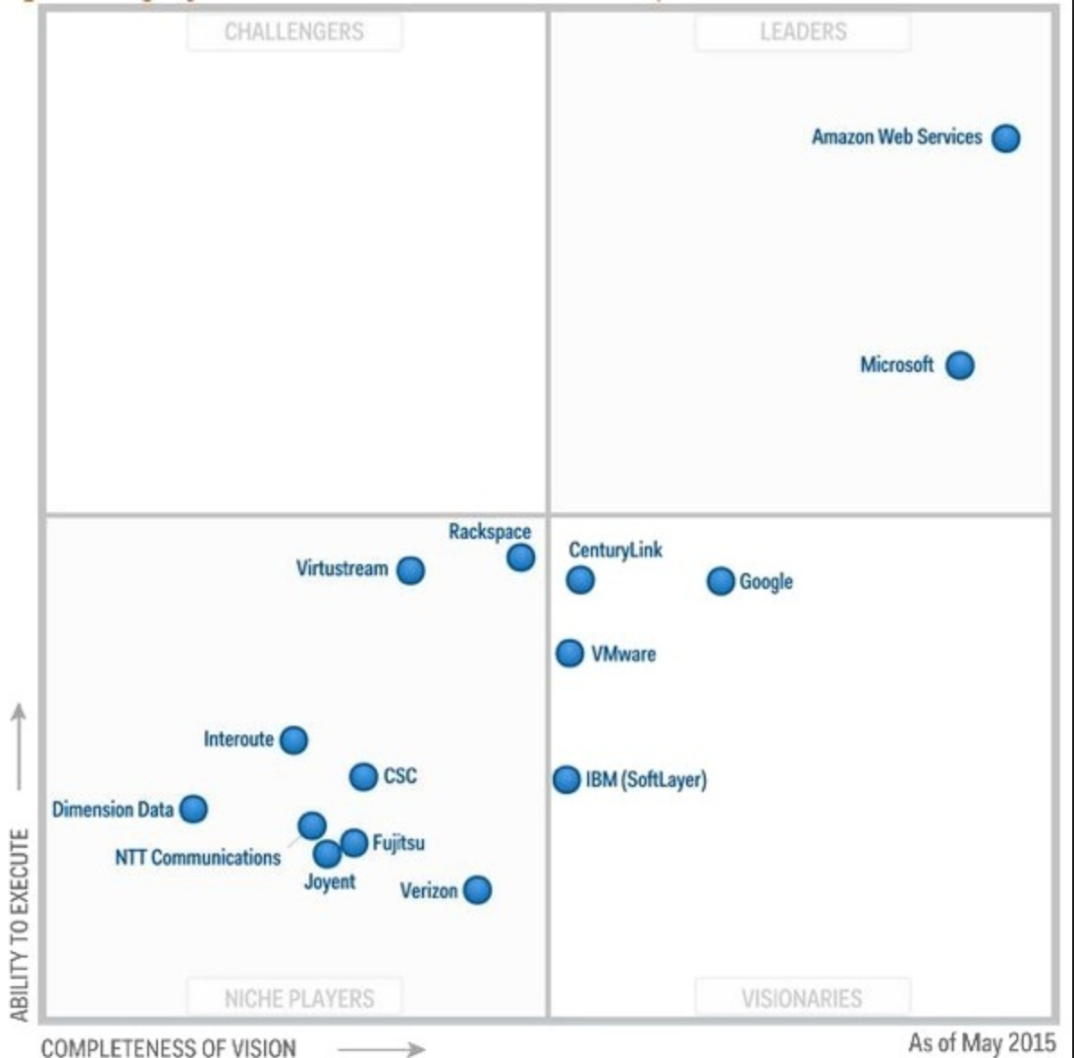
Infrastructure
(IaaS):
Magic
Quadrant
by gartner at 2015
How to read graph:
Leaders execute well against their current vision and are well positioned for tomorrow.
Visionaries understand where the market is going or have a vision for changing market rules, but do not yet execute well.
Niche Players focus successfully on a small segment, or are unfocused and do not out-innovate or outperform others.
Challengers execute well today or may dominate a large segment, but do not demonstrate an understanding of market direction.
Notes:
Software as a Service provides you with a completed product that is run and managed by the service provider.

Slide 37
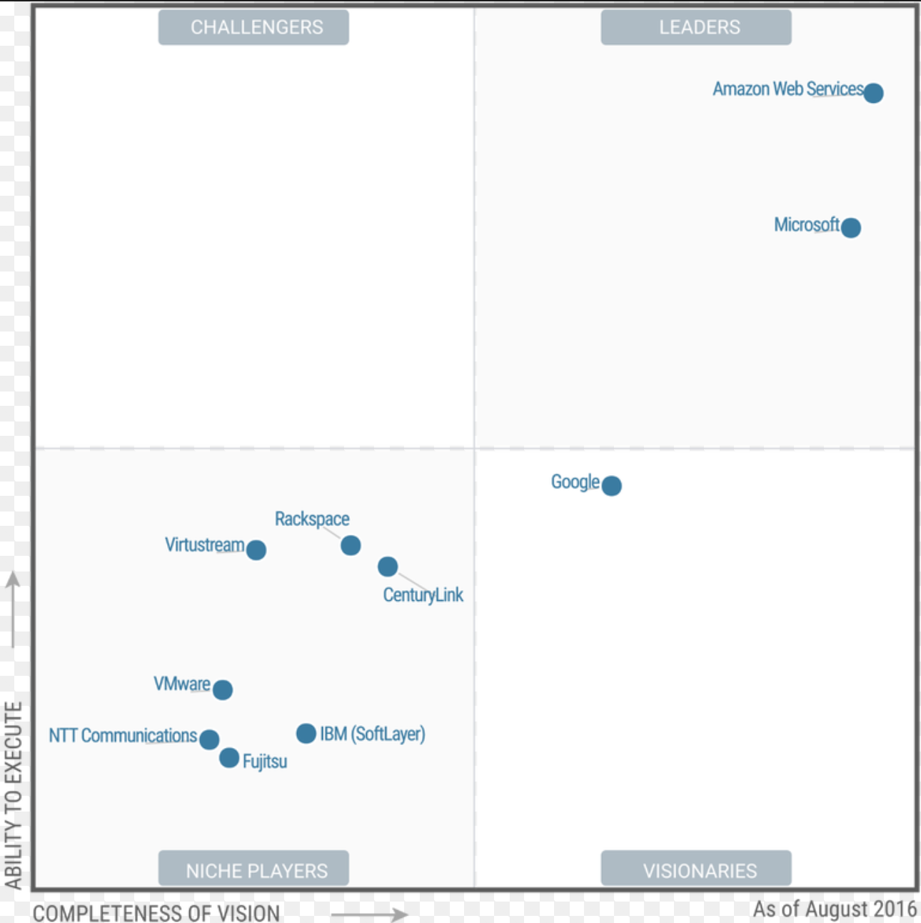
Infrastructure
(IaaS):
Magic
Quadrant
by gartner at 2016
Notes:
Software as a Service provides you with a completed product that is run and managed by the service provider.

Slide 38
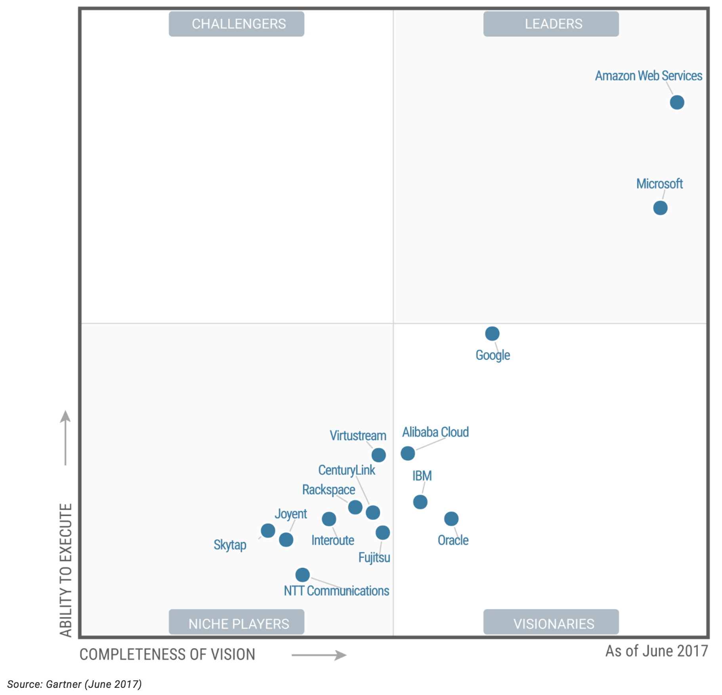
Infrastructure
(IaaS):
Magic
Quadrant
by gartner at 2017
https://www.gartner.com/doc/reprints?id=1-2G2O5FC&ct=150519
Notes:
Software as a Service provides you with a completed product that is run and managed by the service provider.

Slide 39
Function as a Service (FaaS)
Provide you environment to execute your scripts
What you need prepare is your scripts
Event-Driven: In most cases it implements Container-based
High Availability by distributed environment
Volatility: You needn’t to have a data
Notes:
volatility

Slide 40
Function as a Service (FaaS)
How to build or use?
Bring Your Own
OpenWhisk
Fission
Iron.io, Iron Function
Open FaaS
Hosted Service
Amazon Lambda
Google Cloud Functions
Azure Function
Notes:
Software as a Service provides you with a completed product that is run and managed by the service provider.

Slide 41
Matrix: Service/Implementation Model
 | SaaS | PaaS | IaaS
Private Cloud | Various Softwares | CloudFoundry OpenShift WaveMaker RAD | OpenStack CloudStack vSphere Azure Stack VM
Public Cloud | SalesForce Oracle SAP | Heroku GAE PCF | AWS EC2 GCE Azure VM
Hybrid Cloud | Combination your app and cloud services | Combination your app and cloud services | Combination your app and cloud services
※ There are various services other than this
Notes:
Community CloudCloud Foundry
OpenShift
WaveMaker RAD

Slide 42


Slide 43
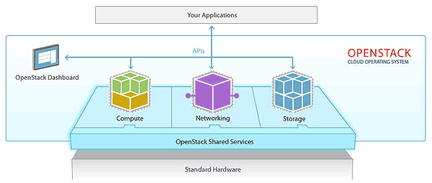
What is OpenStack?
Framework for managing, defining and utilizing cloud resources
Open sources software for creating private and public cloud
It falls under IaaS and also known as Cloud operating system
It is one platform for virtual machines, containers and bare metal

Slide 44
More about OpenStack :
OpenStack controls existing commercial and community technologies like hypervisors, storage systems and networking hardware and software.
OpenStack is composed of collection of projects each with specific purpose
Each OpenStack project has a related code name.
OpenStack Provides an IaaS solution through a variety of complementary services.
Notes:
managed with a web-based dashboard or command-line clients, which allow administrators to control, provision, and automate OpenStack resources.
OpenStack also has an extensive API

Slide 45
With OpenStack Cloud you can..
Utilize the resource of physical and virtual servers, networks and storage systems
Efficiently manage clouds of resources through tenant, quota and roles
And more..

Slide 46



What runs on OpenStack?
Telecom/NFV: Most of the telecom industries using OpenStack to virtualize their network and implementing edge computing
HPC: CERN runs on the openstack
Big Data: Banco Santander runs 1000 of compute node on datacenter across the world.
Multi-cloud: Digital film uses OpenStack private and public cloud to process thousands of hours of footage into one hour TV show.
Web Services: Workday moved their on-demand software services on OpenStack.
E-commerce: Walmart moved global -commerce platform to openstack
Notes:
CERN: the European Organization for Nuclear Research
Banco santandar : Spanish banking group

Slide 47

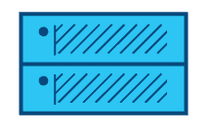
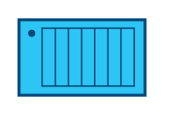
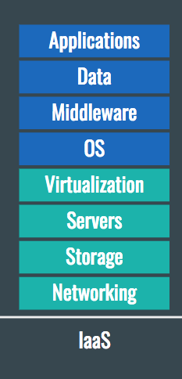
How Openstack manage the resource??
OpenStack Dashboard
provides UI to services
OpenStack manages the
resources
Network
Compute
Storage
Vendors provide resources
Vendor network
Vendor Hypervisor
Vendor storage system
Used by virtual machines
VM network
VM compute
VM volume

Slide 48
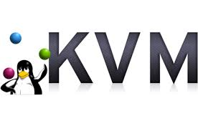
OpenStack manage “Hypervisor”
OpenStack Compute
Manages the hypervisor
Network
Compute
Storage
Server hardware
Virtual hardware
CPU RAM Disk
VM compute

Slide 49
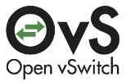
OpenStack manage “Network”
OpenStack provides network
services like DHCP, routing,
Network
Compute
Storage
Open vSwitch(OVS)
Vendor Network
Server hardware
VM Compute
VM Network

Slide 50

OpenStack manage “Storage”
Network
Compute
Storage
Server hardware
Vendor network
Vendor storage system
VM Network
VM Compute
VM Volume

Slide 51
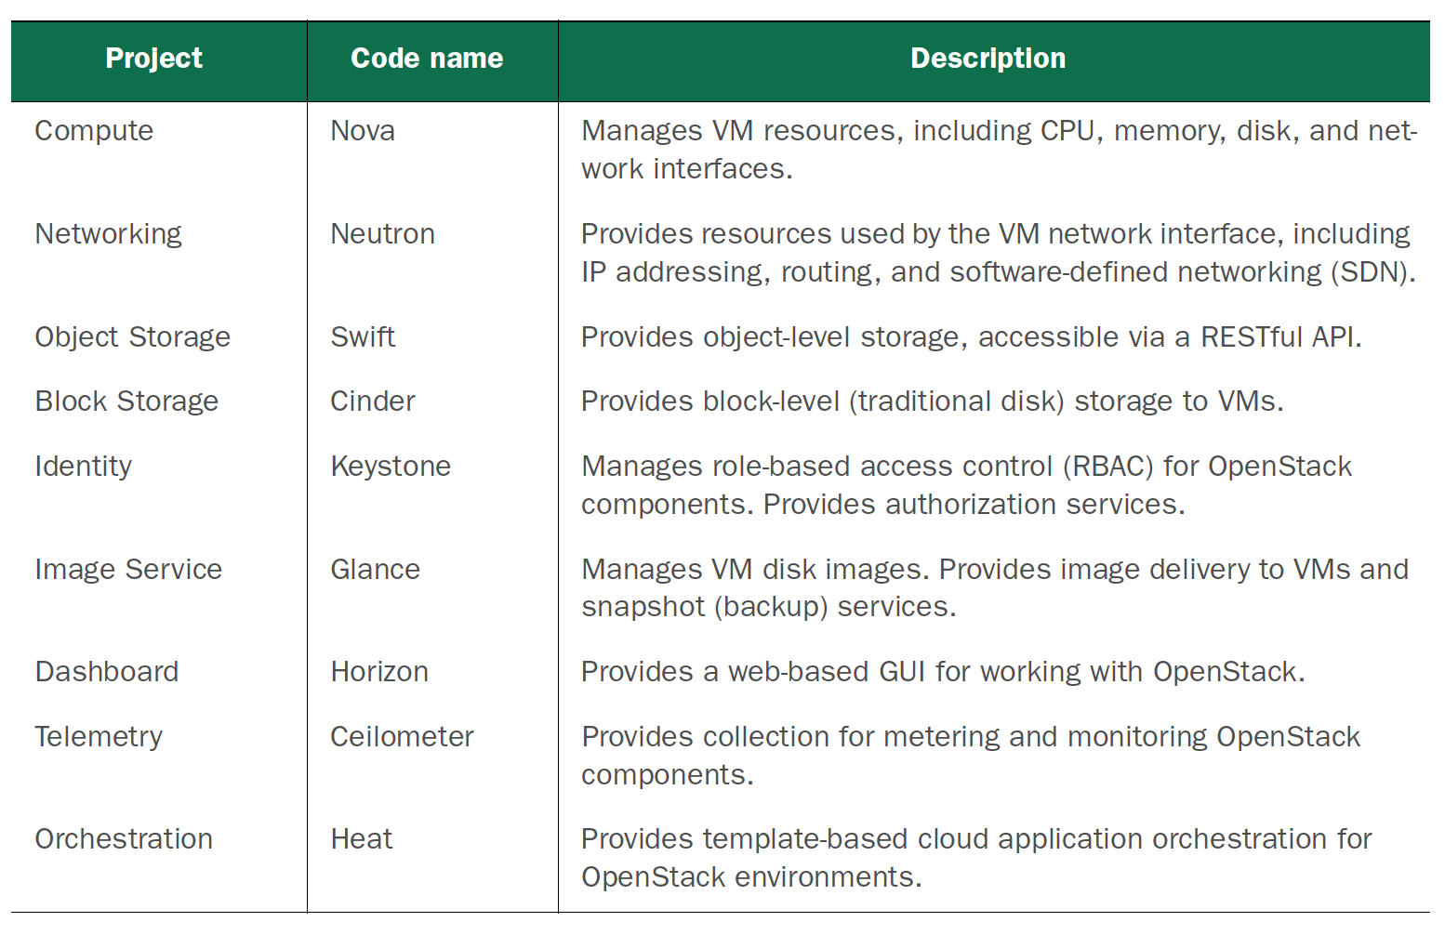
Core projects:

Slide 52
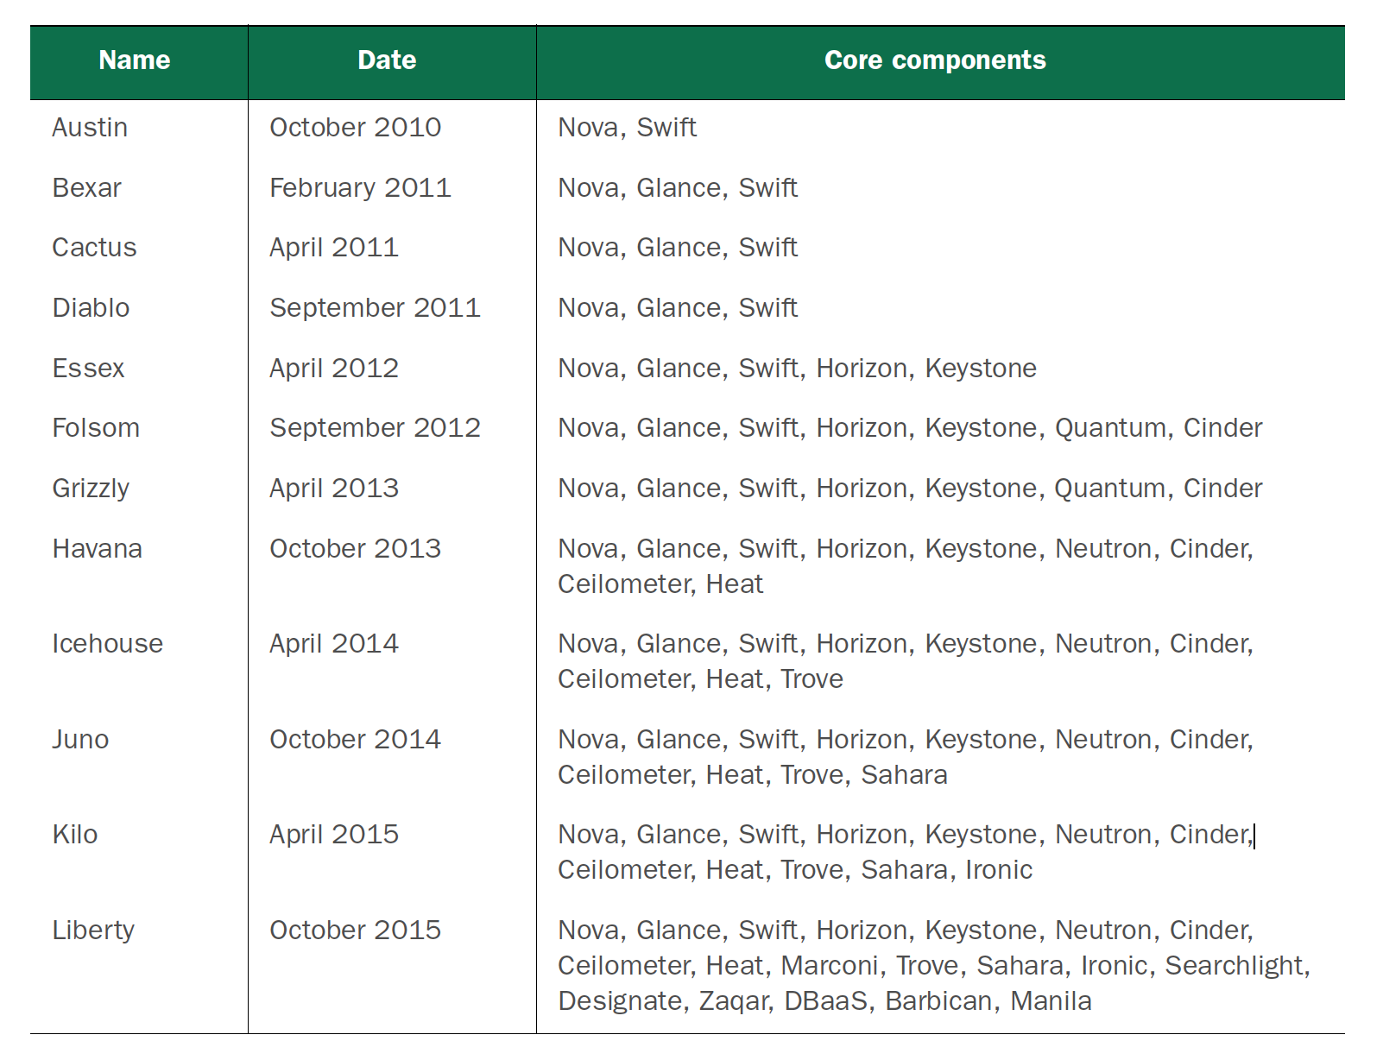
OpenStack Releases

Slide 53
OpenStack Releases
Newton
Ocata
Pike
Queens
Rocky
Oct 2016
Feb 2017
Aug 2017
Feb 2018
Oct 2018
Under development
Release every 6 months

Slide 54
Rapid OpenStack deployment tool : DevStack

Slide 55
What is Devstack?
OpenStack is a distributed cloud framework, but all components can be installed on a single server
Devstack bring up a complete OpenStack environment based on the latest version in a single node.
OpenStack can be accessed from a web-based dashboard, a command-line interface, or web-based RESTful APIs
Build the Devstack from here. https://docs.openstack.org/devstack/latest/

Slide 56
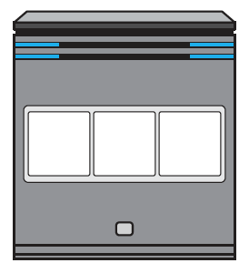
Before:
DevStack Server
(Fresh Linux install)
Install OpenStack software and
related dependencies
Execute DevStack
Network
Compute
Storage
After:
Edit local.conf
DevStack Server
(OpenStack Deployment)
Configure Openstack components
to work with each other
./stack.sh
Network
Compute
Storage

Slide 57
But we do not use Devstack for Development!!

Slide 63
Who uses DevStack?
Developers working on OpenStack
Used to test changes and verify their work in a running OpenStack deployment
Used by OpenStack Community Contributor as they push their patch into gerrit for review
Used for demos and POC ( Proof of concept work)

Slide 64
Manual Installation of OpenStack Components

Slide 65

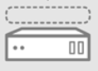

Deployment Roadmap
User
Controller node
HTTP Service
Compute node
Horizon
Glance
Nova
nova-compute
Neutron
Glance API
nova-api
Keystone
Libvirtd-driver
Cinder
Glance Registry
Nova-certi
Neutron
nova -scheduler
Cinder
Rabbit-MQ
nova -conductor
cinder-api
Native Hypervisor
Cinder-
backup
nova -consoleauth
Cinder- scheduler
nova -proxy
Connectivity
Cinder-
volumn
Service
Node
Storage
Component
Notes:
Connectivity

Slide 66
Accessing to OpenStack Staging Env.
Click following link to access to OpenStack Staging Env. using
Username and Password provided to you.
http://10.1.40.2/horizon/auth/login/

Slide 67
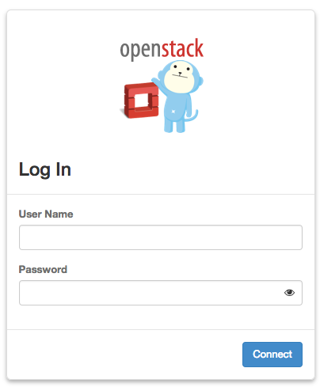
Log In Page
Type your Username and password Provided in your sheet and press Connect

Slide 68
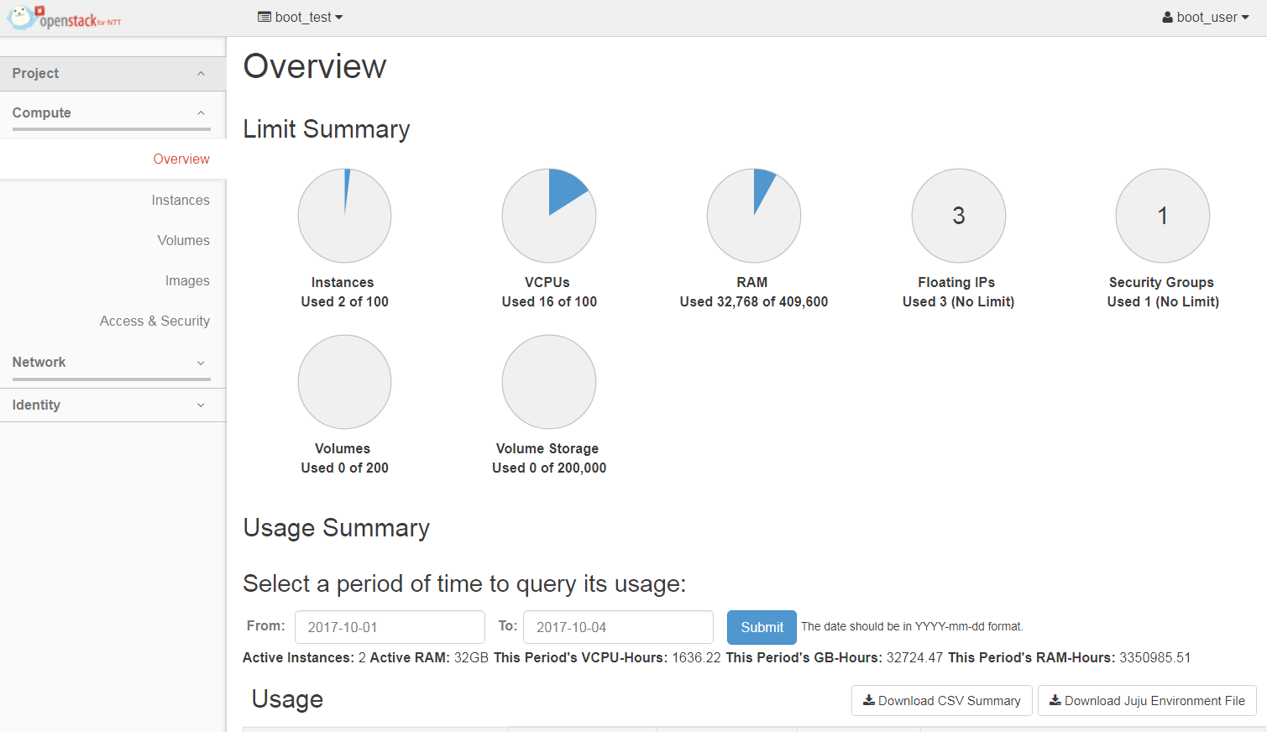
After login
Tenant
User

Slide 69
Few operations to perform after login..
**For Mac Users**
For Window System → Pg. 74.

Slide 70
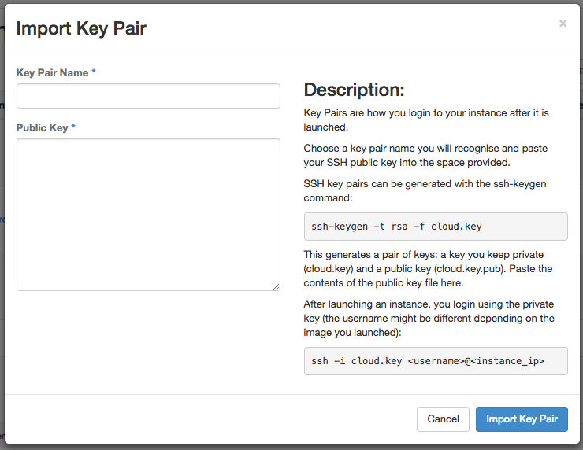
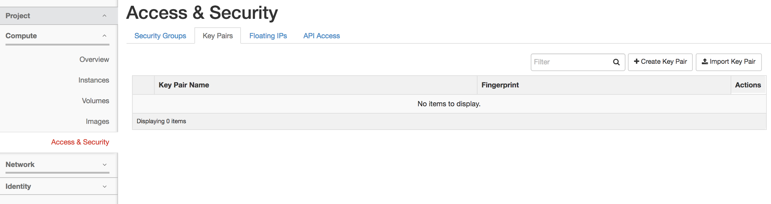
Creating Key Pair
Key Pairs are how you login to your instance after it is launched.
Create Key pair on your mac system using following command
$ cd ~/.ssh
$ ssh-keygen -t rsa -f <key_pair_name>
$ cat <key_pair_name>.pub
Copy and paste contents of <key_pair_name>.key here

Slide 71
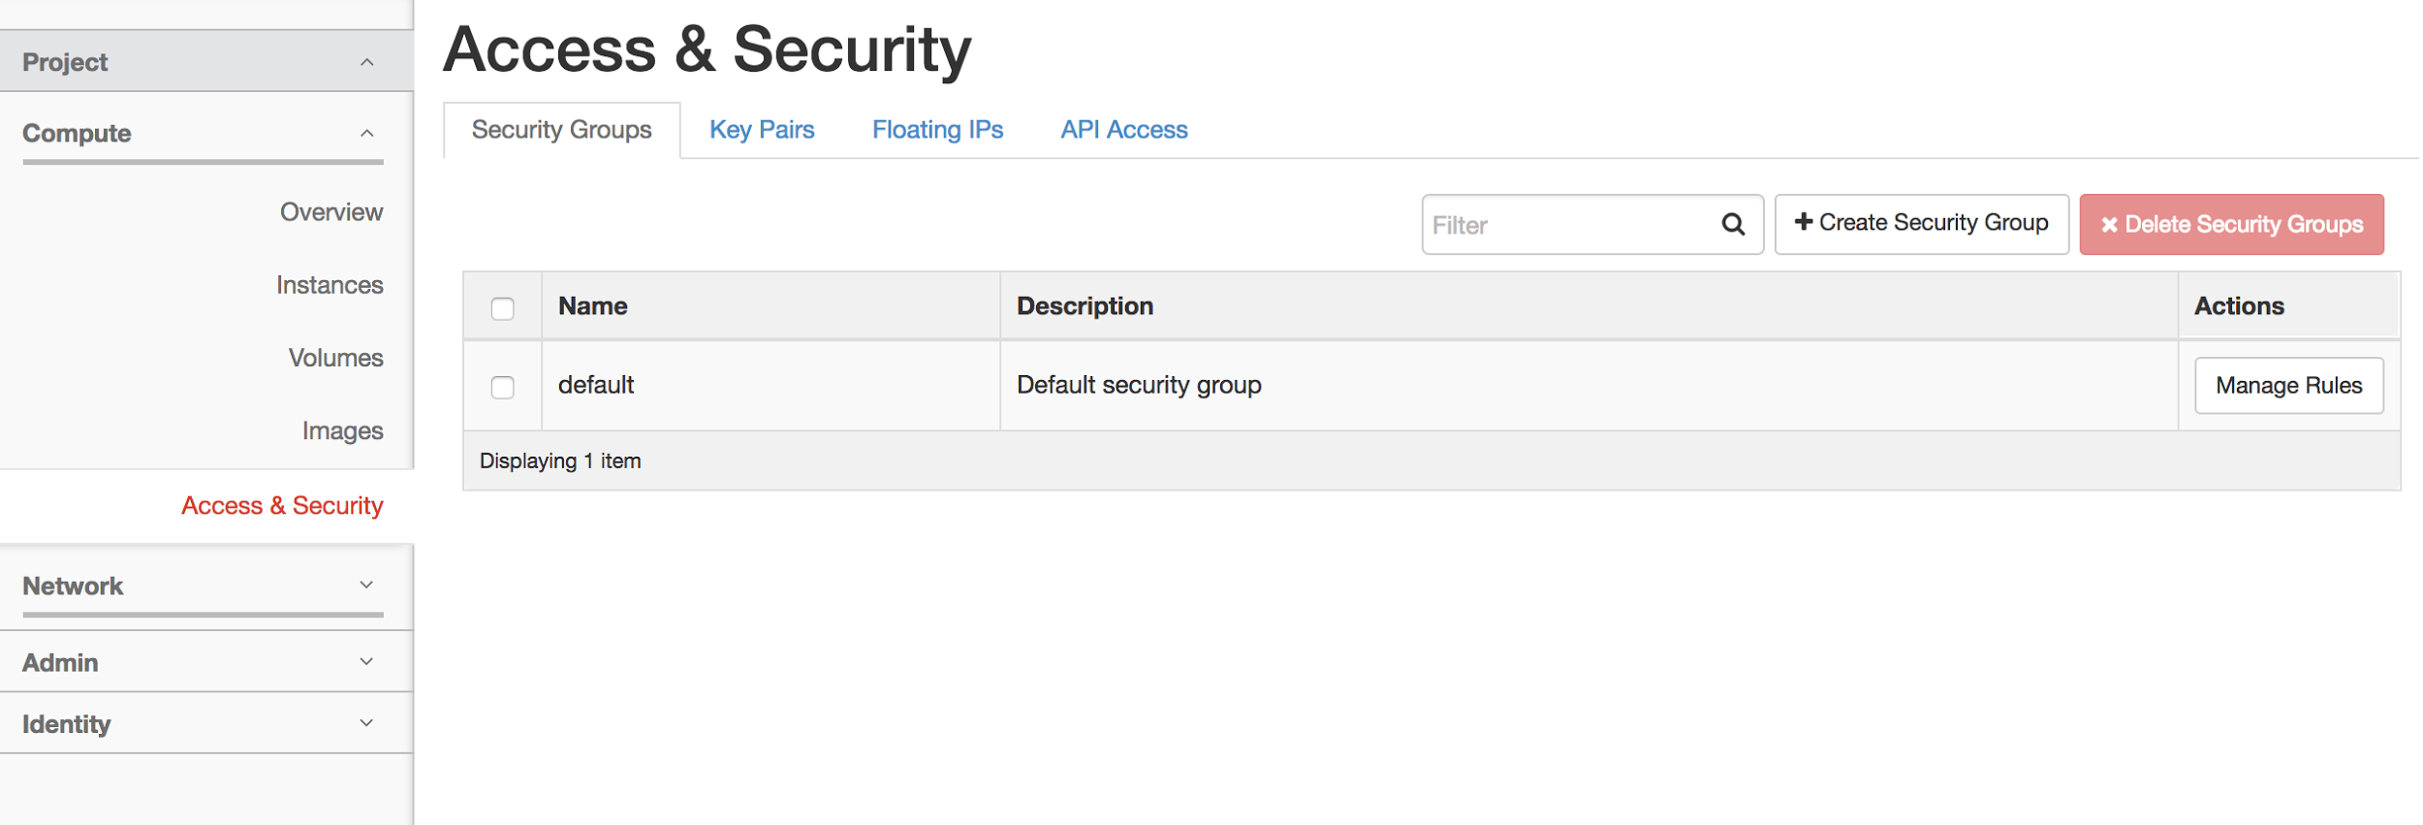
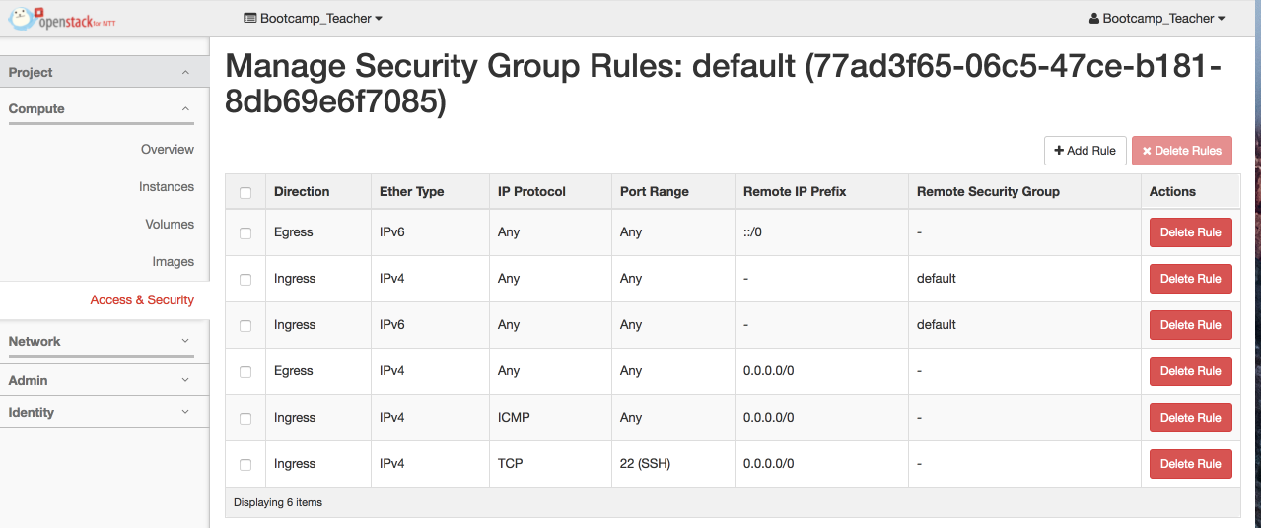
Manage Security rules
To get access of Instance from your local machine, follow this steps.
Click Access & Security
Click Security Groups
Click Manage Rules
Add SSH rule
This is already done, You do not need to do it again!!

Slide 72
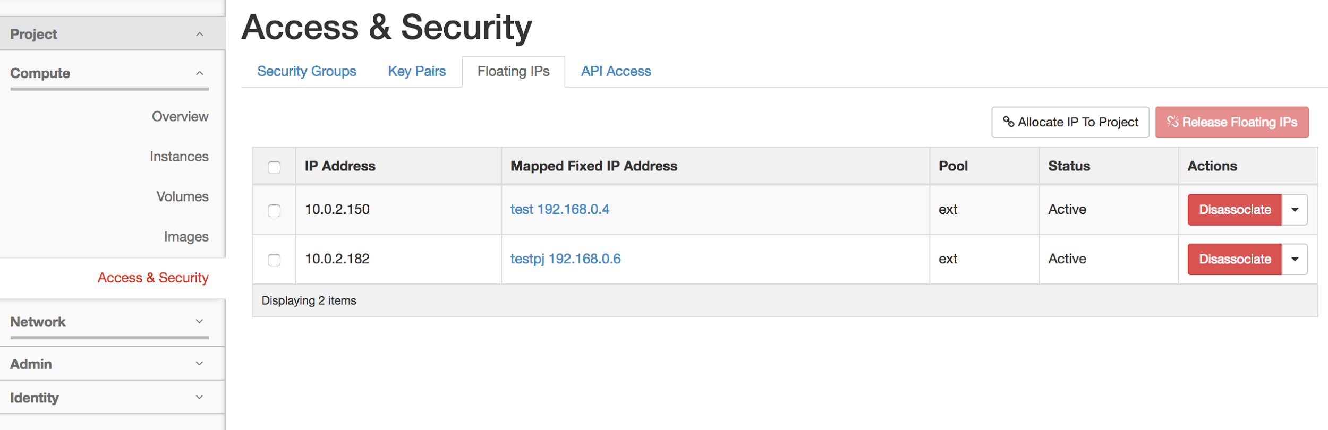
Adding Floating IPs
To assign Floating IPs to your project, follow this steps.
Click Access & Security
Click Floating IPs
Click Allocate IP to Project
This is already done, You do not need to do it again!!

Slide 73
Creating Instances

Slide 74
Creating instance
We need two instance for our Environment
viz. Controller node and Computer Node
Tenant : bc_cloud_tnt#
Controller node
Compute node
# CPU?
# RAM
# CPU
# RAM
#Storage
2 NIC
# Storage
2 NIC
Flavor ??
Flavor ??

Slide 75
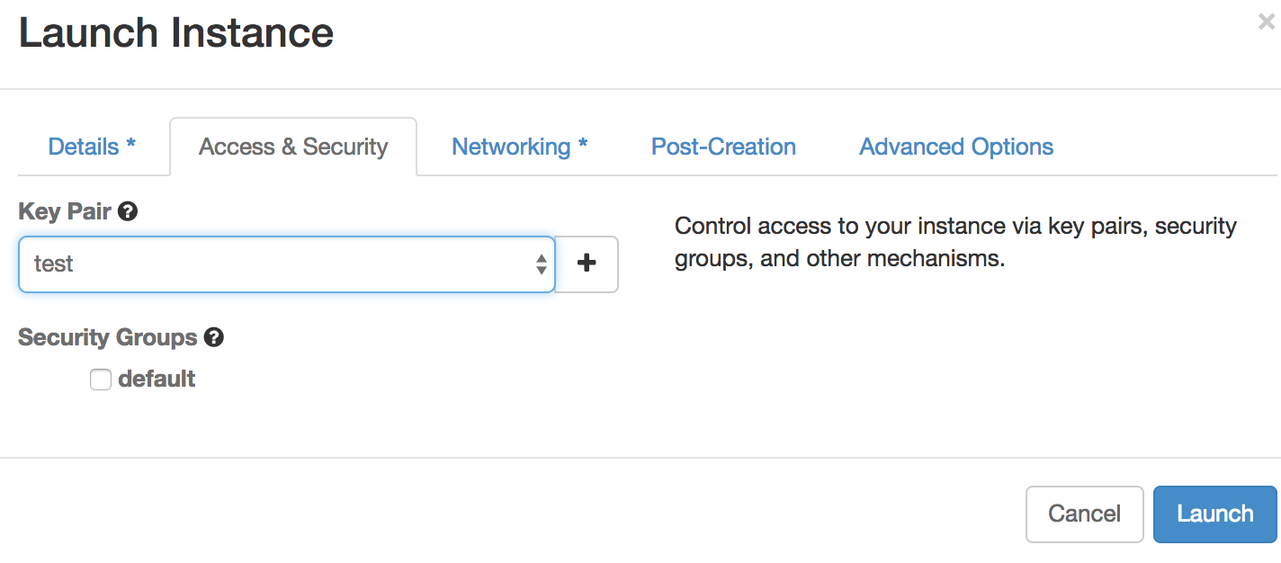
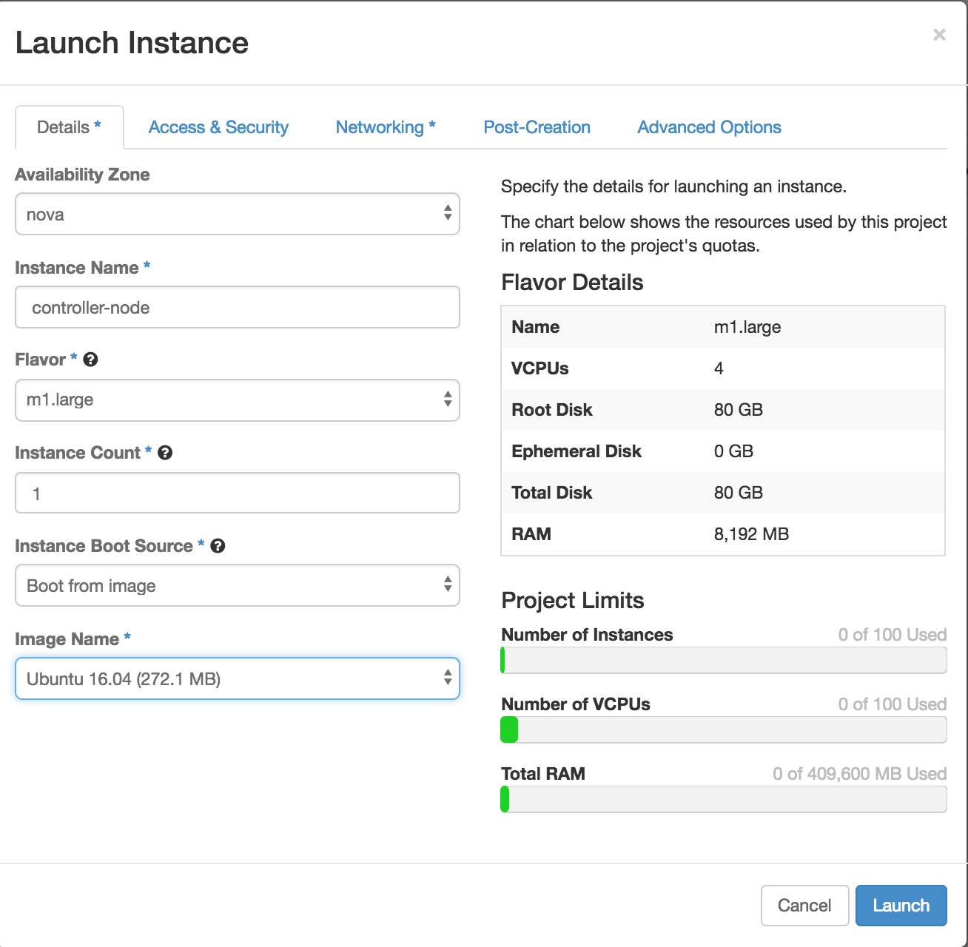
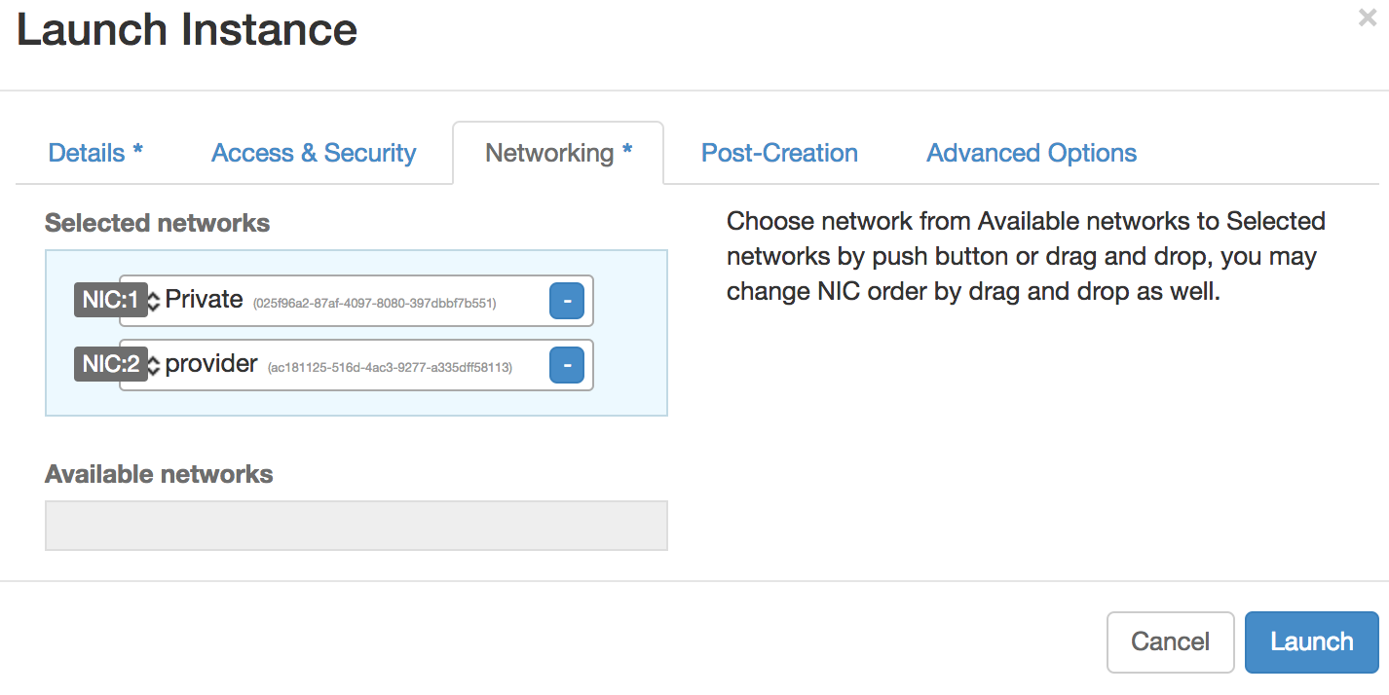
Creating instances
Assign key to instance
Click Launch instance and Choose specification for instance
1
2
Select Network for instance

Slide 76
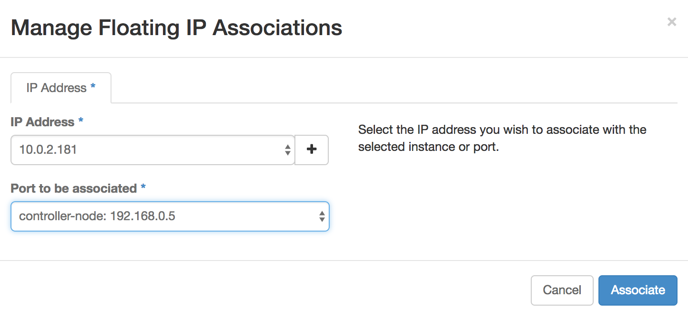
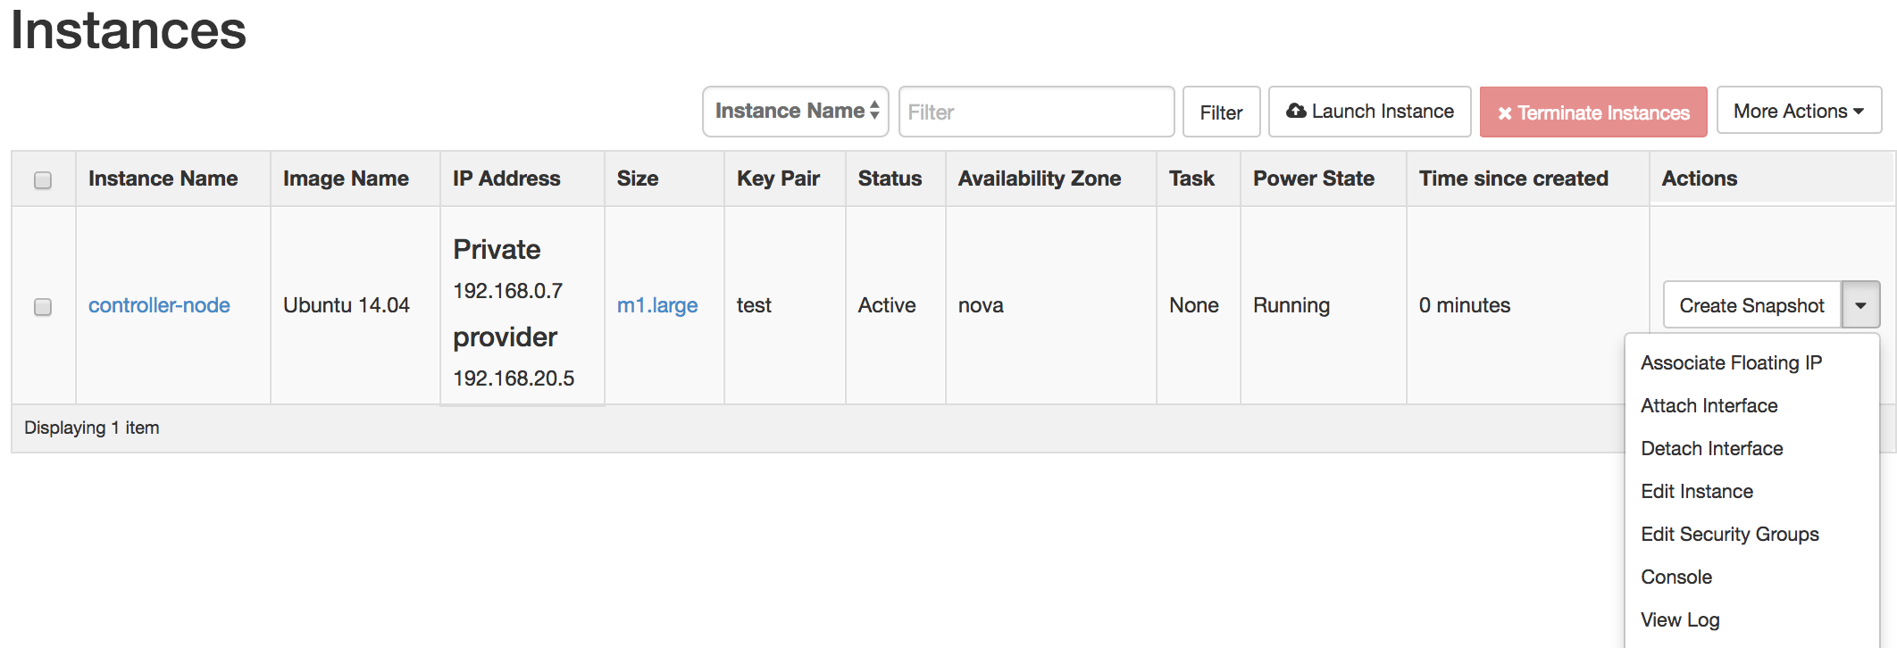
Assign Floating IP to instance
We have to assign floating IP to instance to access it externally
We have two network viz. Private and Provider Network
Assign Floating IP to Private Network

Slide 77
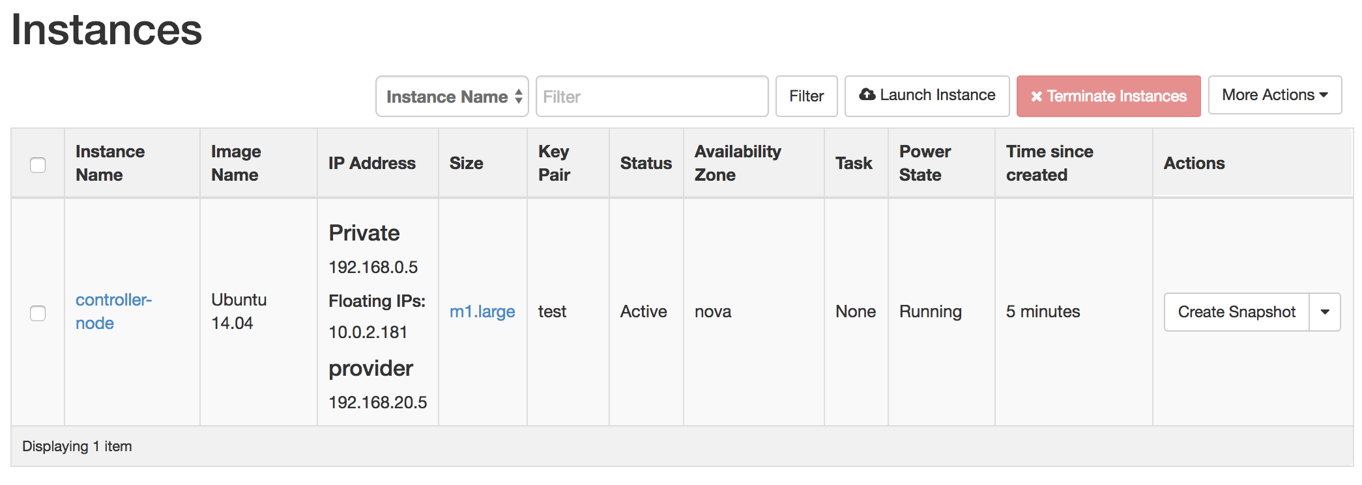
Accessing Nodes through SSH
After launching an instance, you login using the
private key through your system using following command
$ ssh -i <key_pair_name> <username>@<Floating_IP>
Floating IP is here

Slide 78
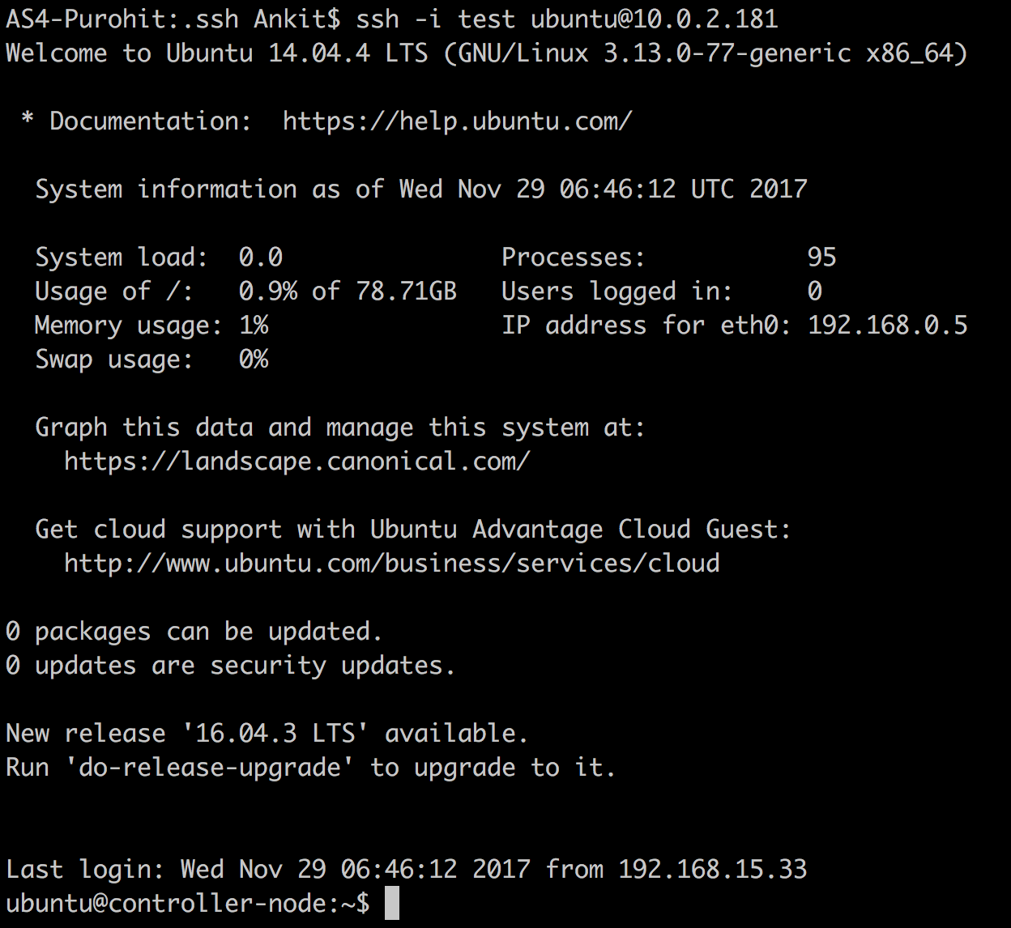
After SSH
Private Key
Floating IP
**Do this for both controller and Compute node Nodes**

Slide 79
Few operations to perform after login..
**For Windows Users**

Slide 80
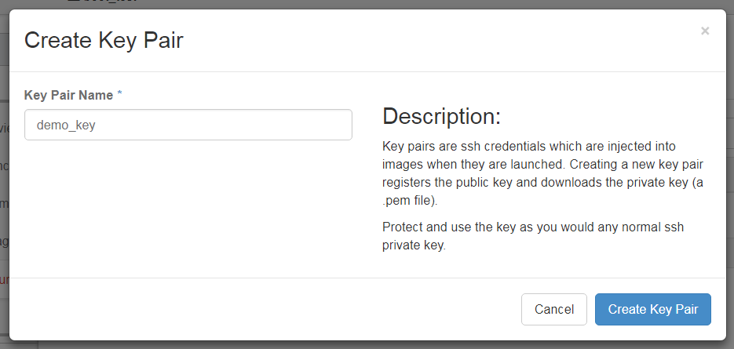
Creating Key Pair
- Type desired name for your keypair
- Save a .pem file on convenient location
where you can access it easily.

Slide 81
Creating instance
We need two instance for our Environment
viz. Controller node and Computer Node
Tenant : bc_cloud_tnt#
Controller node
Compute node
# CPU?
# RAM
# CPU
# RAM
#Storage
2 NIC
# Storage
2 NIC
Flavor ??
Flavor ??

Slide 82
Creating instances
Assign key to instance
Click Launch instance and Choose specification for instance
1
2
Select Network for instance

Slide 83
Assign Floating IP to instance
We have to assign floating IP to instance to access it externally
We have two network viz. Private and Provider Network
Assign Floating IP to Private Network
Floating IP is here

Slide 84
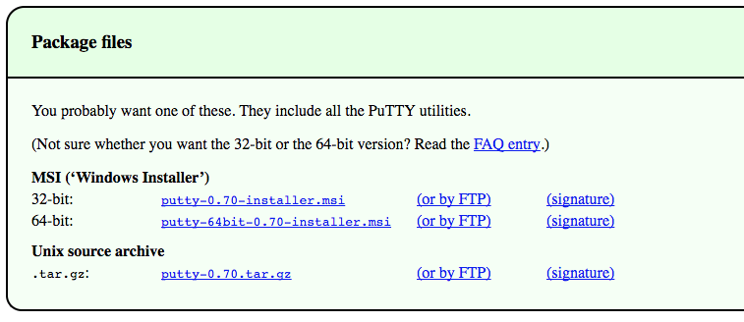
Putty
Click following link to download and install Putty and PuttyGen in your windows system
Check your System type << Control Panel -> System and Security -> System >>
Download Putty and PuttyGen Here

Slide 85
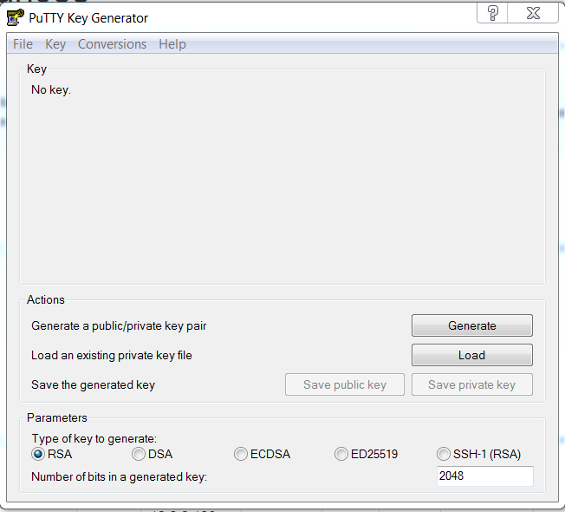
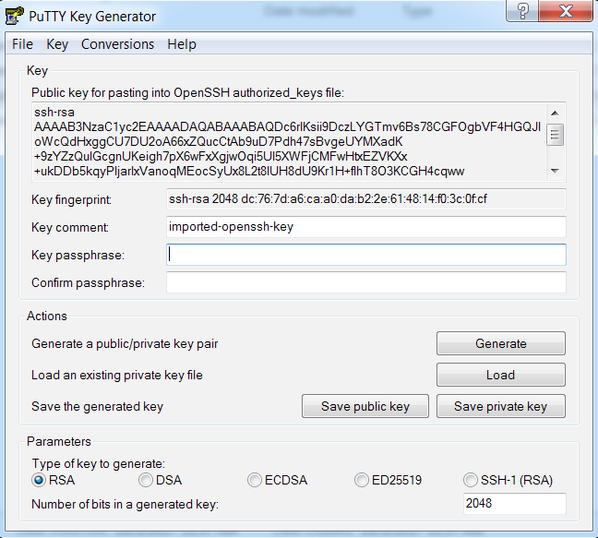
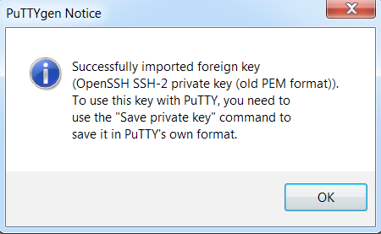
Converting a key
Convert your key to rsa using following step.
Start PuTTYgen (start menu->All Programs -> PuTTYgen)
Click Load
Browse for the key you saved before(demo_key.pem)
Click ok and save your private key

Slide 86
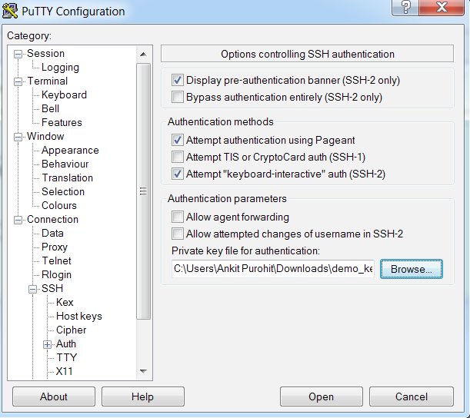
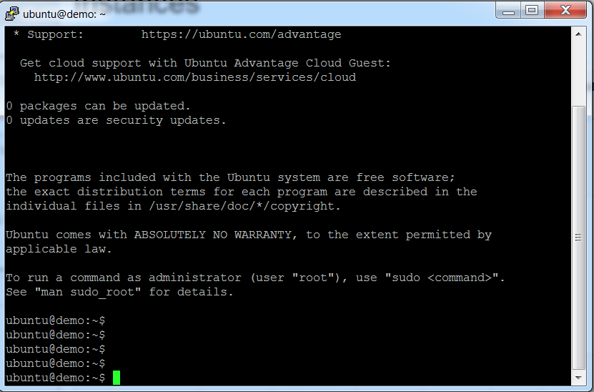
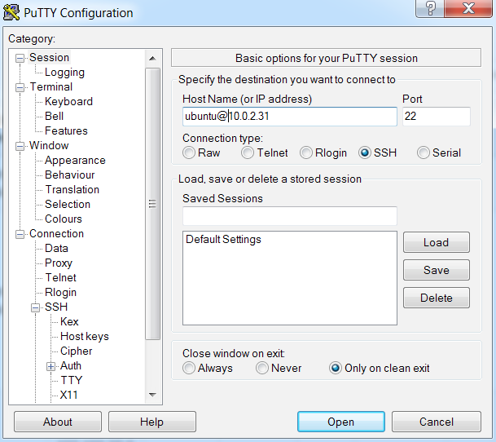
Using Key with Putty
Open Putty -> SSH -> Auth -> Browse
Select your private key you just saved in last step.
Session -> Username@floating IP -> Open
Do this for both controller and compute Nodes
This should be floating IP

Slide 87
Now we are ready to Build our OpenStack!!!!

Slide 88
Prerequisites
Configure the network
Setup Time Zone
Enable OpenStack repository(Ocata)
SQL database(MariaDB)
Message queue(RabbitMQ)
Memcached

Slide 89
Prerequisites
Configure the network
Perform < #Sudo apt-get update > on each node
Check your current interface using < #ifconfig > (eth# or ens#)
Also make note of IP address of both the nodes
For Controller Node:
Click here to configure the network for controller node
After performing ↑ operations, run these cmd
- #Sudo ifup eth#
- #ifconfing (Check if eth# or ens# is up or not)
!
Notes:
Before this update your ubuntu
Management interface is already configured
Sudo su -

Slide 90
Configure the network
After performing ↑ operations, run these cmd
- #Sudo ifup eth1
- #ifconfing (Check if eth1 or ens4 is up or not)
For Compute Node:
Click here to configure the network for compute node
!

Slide 91
Prerequisites
2. Set TimeZone
# date -> Perform it on both the node. If there is time lag perform following
# cp /usr/share/zoneinfo/Asia/Tokyo /etc/localtime
# date (Confirmation)
**By Default, the controller node synchronises the time via a pool of public server**
Notes:
Network Time Protocol is a networking protocol for clock synchronization between computer systems over packet-switched, variable-latency data networks.

Slide 92
Prerequisites
2. Enable OpenStack repository
The setup of Openstack packages need to to be done on all Nodes
For Controller node
Click here to to enable OpenStack repository for controller node
For Compute Node
Click here to to enable OpenStack repository for compute node
!
!

Slide 93
Prerequisites
3. SQL database
Openstack services use SQL database to store the information
It runs on the controller node
Install and configure SQL component from here
Click here to install and configure the SQL database in Controller node
!

Slide 94
Prerequisites
4. Message queue
Openstack uses message queue for guaranteed delivery and ordering of messages in large distributed systems among the services.
Message queue runs on the Controller node
Openstack uses RabbitMQ messaging service as default queuing system.
Install and configure RabbitMQ service from here.
Click here to install and configure RabbitMQ on controller node
!

Slide 95
Prerequisites
5. Memcached
Identity service uses Memcached to cache the tokens.
It runs on the Controller node
Install and configure component from here
Click here to install and configure Memcached on controller node
!

Slide 96
Start installing components now..

Slide 97
Deployment Roadmap
User
Controller node
HTTP Service
Compute node
Horizon
Glance
Nova
nova-compute
Neutron
Glance API
nova-api
Keystone
Libvirtd-driver
Cinder
Glance Registry
Nova-certi
Neutron
nova -scheduler
Cinder
Rabbit-MQ
nova -conductor
cinder-api
Native Hypervisor
Cinder-
backup
nova -consoleauth
Cinder- scheduler
nova -proxy
Connectivity
Cinder-
volumn
Service
Node
Storage
Component
Notes:
Connectivity

Slide 98
Identity Service : “Keystone”
Keystone is OpenStack Service that provide API client authentication, Service discovery and distributed multi-tenancy authorization by implementing OpenStack Identity API.
It supports LDAP, OAuth, OpenID connect, SAML and SQL
It simply process API requests, provide identity, token, catalog and policy service.
Installed on Controller node
!
Notes:
LDAP(lightweight directory access protocol) : software protocol for enabling anyone to locate organizations, individuals, and other resources such as files and devices in a network, whether on the public Internet or on a corporate intranet.
OAuth: Allows secure authorization
OpenID Connect: simple identity layer on top of the OAuth protocol. allows Clients to verify the identity of the End-User based on the authentication performed by an Authorization Server, as well as to obtain basic profile information about the End-User in an interoperable and REST-like manner.
SAML (Security assertion markup language) : exchanging authentication and authorization data between parties, in particular, between an identity provider and a service provider.

Slide 99
Identity Service : “Keystone”
Following diagram shows the basic authentication flow that identity service uses
to authenticate with other components
User
OpenStack-
Keystone
Optional Identity Backend
( ex.LDAP, Active Directory)
Horizon Service
All Service
Database
Notes:
By default uses MeriaDB back end for token, catalog, policy, and identity information.

Slide 100
Identity concept in Keystone
Tenant(Projects) : It can be user group, projects or organization
Users : Access to services
Role : It determines user permissions
User 1
User 2
User 3
Users can be part of many Projects
Users can have different role in different projects
Member
Project 1
Project 3
Project 1
Admin
Project 2
Project 2
Project 3

Slide 101
Identity concept in Keystone
The following figure shows example of user assignment to user groups and
its role to each of the user groups
Tenant : UG-01
Tenant : UG-02
OpenStack Role
Admin
Member
etc
User : Ankit
User : Ankit
Role : Admin
User : Ankit
Role : Member
New user assigned to tenant
User is given certain role
Same user can have different role in a different tenant

Slide 102
(Hands-On) Installing Keystone
Please use
Password : “ openstack ”
for all services for your convenience
Install and configure
Create database
Install and configure keystone
click here to install and configure the OpenStack Identity service on controller node
Create a domain, Projects, users and role
Click here to create domains, projects, users, and roles.

Slide 103
(Hands-On) Installing Keystone
Verify the operation
**Verify the operation of the Identity service before installing other services**
Click here to verify the Operation

Slide 104
(Hands-On) Installing Keystone
Creating the script(OpenRC)
To increase the efficiency of client operation, OpenStack support simple client environment scripts aka OpenRC file.
Click here to Create OpenStack client environment scripts

Slide 105
Deployment Roadmap
User
Controller node
HTTP Service
Compute node
Horizon
Glance
Nova
nova-compute
Neutron
Glance API
nova-api
Keystone
Libvirtd-driver
Cinder
Glance Registry
Nova-certi
Neutron
nova -scheduler
Cinder
Rabbit-MQ
nova -conductor
cinder-api
Native Hypervisor
Cinder-
backup
nova -consoleauth
Cinder- scheduler
nova -proxy
Connectivity
Cinder-
volumn
Service
Node
Storage
Component
Notes:
Connectivity

Slide 106
Image Service : “Glance”
It is the module used to discover, deploy and manage VM images in the OpenStack environment.
This service let compute service(Nova) know where to pick the image from.
Can store virtual machine images at verity of location such as object storage system, simple file system or external web services.
Installed on Controller node
!
Notes:
Openstack-glance-api : interacts with storage back ends to handle requests for the image retrival and storage.
It uses openstack-glance registry to retrive image information
Openstack-glance registry : Manages all matadata for eac image (size, type)

Slide 107
Image Service : “Glance”
The following diagram shows the main interfaces that the image service uses to register and retrieve the images from image database.
User
Identity Service
openstack-glance-api
Compute Service
openstack-glance-registry
Object Service
Image database

Slide 108
Component in Glance :
openstack-glance-api:
Interacts with storage backend to handle request for the image retrieval and storage
openstack-glance-registry:
Manages all the metadata about each of the images
Metadata includes size, type of images.

Slide 109
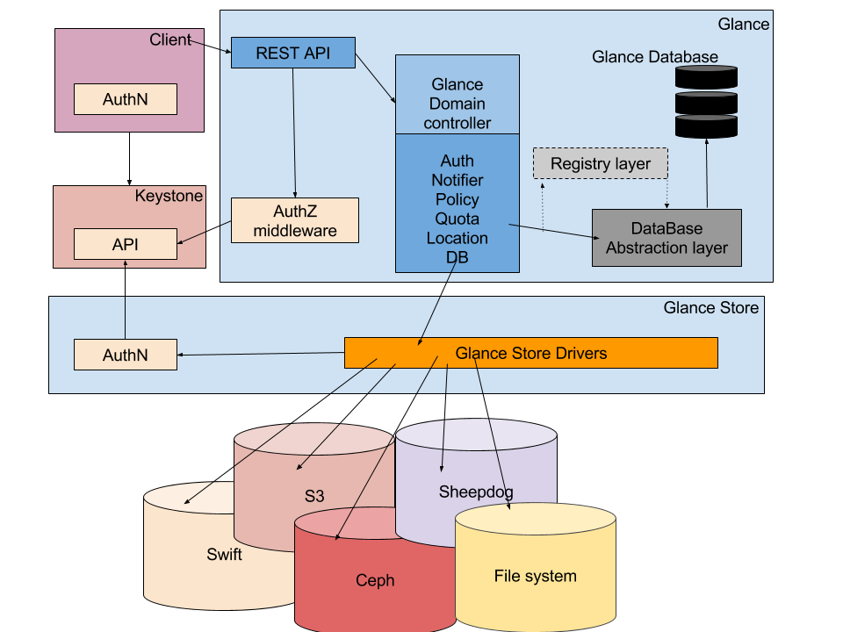
Glance Architecture :
Middleware that Manages:
- Authorization,
- Notifications,
- Policies,
- Database connections
Exposes Glance functionality via REST
Any application that uses Glance server
Unifies the communication between Glance and databases
Organize interaction between Glance and various data stores
http://www.sparkmycloud.com/blog/wp-content/uploads/2016/01/Untitled-drawing11.png

Slide 110
Glance Format :
Disk Format | Description
Raw | Unstructured disk format
VHD | Most common format supported by most OpenStack virtualization technologies except KVM
VMDK | Format popularized by VMware
qcow2 | QEMU image format, native format for KVM and QEMU. Supports Advanced functions
VDI | Virtual disk image format originated by Oracle VM VirtualBox
ISO | Archive format for optical disks
AMI, ARI, AKI | Amazon machine, ramdisk and kernel images res.

Slide 111
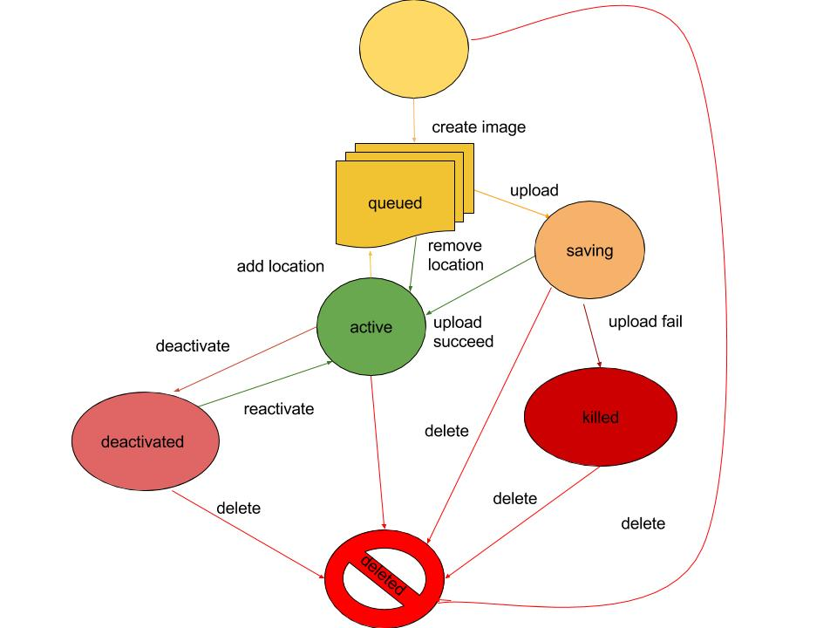
Glance Status Flow:
Glance status flow shows the status of the image while creating and uploading.

Slide 112
(Hands-On) Installing Glance
Install and configure
Create Database, Service Credentials and API endpoints
Install and configure Glance
Click here to install and configure the Glance service on Controller node
Verify Operation
Click here to verify the Operation

Slide 113
Notification
When today lecture finished Please answer the following questionnaire Day 1: Click here to give your precious feedback
Notes:
questionnaire

Slide 114
Day 2 :
9:30 ~ 12:00 : Installing Nova
12:00 ~ 13:00 : Lunch Break
13:00 ~ 15:30 : Installing Neutron
15:30 ~ 14:30 : Installing Horizon and understanding the dashboard
17:00 ~ 17:30 : Feedback and wrap up

Slide 115
Deployment Roadmap
User
Controller node
HTTP Service
Compute node
Horizon
Glance
Nova
nova-compute
Neutron
Glance API
nova-api
Keystone
Libvirtd-driver
Cinder
Glance Registry
Nova-certi
Neutron
nova -scheduler
Cinder
Rabbit-MQ
nova -conductor
cinder-api
Native Hypervisor
Cinder-
backup
nova -consoleauth
Cinder- scheduler
nova -proxy
Connectivity
Cinder-
volumn
Service
Node
Storage
Component
Notes:
Connectivity

Slide 116
Compute Service : “Nova”
Manage lifecycle of Virtual Machine (VM)
Create, Delete, Resume, Resize etc. VM
Pluggable/hybrid hypervisor support
Xen, lxc, Hyper V, ESXi, KVM
Built on top of messaging-based architecture
Each component cooperate with Messaging Queue
Notes:
Openstack-glance-api : interacts with storage back ends to handle requests for the image retrival and storage.
It uses openstack-glance registry to retrive image information
Openstack-glance registry : Manages all matadata for eac image (size, type)

Slide 117
Components in Nova
Components interaction via Messaging Queue (MQ) or External Service
Interaction via REST API
nova-api
Messaging Queue
nova-conductor
Database
nova-scheduler
nova-compute
nova-novncproxy
nova-consoleauth
Notes:
Openstack-glance-api : interacts with storage back ends to handle requests for the image retrival and storage.
It uses openstack-glance registry to retrive image information
Openstack-glance registry : Manages all matadata for eac image (size, type)

Slide 118
Components in Nova: nova-api
Provide API for users and other services to interact with NOVA
with CLI or GUI (called Horizon)
Direct Access to REST API
https://developer.openstack.org/api-ref/compute/
Tasks are categorized the following in Nova
Task by API call
Periodic Task (does not use nova-api)
host information, instance information on compute node
Notes:
There is also a thing that does not pass through the Nova-api

Slide 119
Components in Nova: nova-scheduler
Dispatch requests for new virtual machine to correct node
Use Filtering or Weighting function
After filtering, do weighting
https://docs.openstack.org/nova/pike/user/filter-scheduler.html
VM
Node A
Host A
Weight: 80
Launch
Node B
Filtering
Host B
Weighting
Host B
Node C
Host C
Weight: 20
Node D
Host D
Host D
Compute Nodes
Notes:
There is also a thing that does not pass through the Nova-api

Slide 120
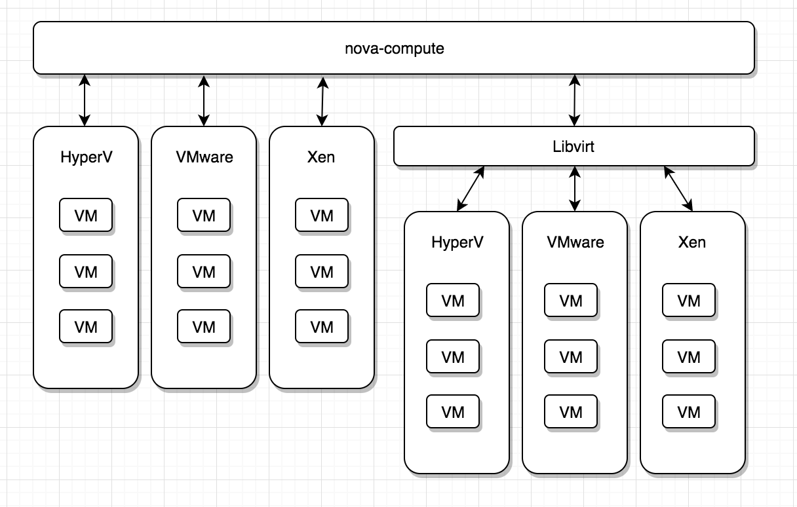
Components in Nova: nova-compute
Run on each nodes to manage lifecycle of VM instances
Interact with hypervisor to create new instance
Ensure that the instance state is maintained in database
Notes:
There is also a thing that does not pass through the Nova-api

Slide 121
Components in Nova: other components
nova-conductor
Provide database-access support for Compute nodes
Some information about instance is managed via nova-conductor
nova-consoleauth
Provide console authentication
nova-novncproxy
Provide VNC (virtual network console) proxy for browsers
Enable VNC consoles to access virtual machines
Other
nova-api-metadata, nova-placement-api, nova-spicehtml5proxy, etc.
Notes:
There is also a thing that does not pass through the Nova-api

Slide 122
Nova and Messaging Queue (AMQP) interaction
API services process REST Requests
Involve database reads or writes
Optionally, sending RPC messages to other Nova services
After processed RPC requests, generating response to the calls
RPC: Remote Procedure Call
Execute functions in specific process via network
RPC Messaging is done via “oslo.messaging library”
abstract on top of messaging queue
Notes:
There is also a thing that does not pass through the Nova-api

Slide 123
Nova and Messaging Queue interaction
Function name and parameters executed via RPC is included in message
Receiver (called Subscriber) is received its message via MQ
After executed function on receiver, reply response message via MQ
Publisher
Subscriber (Receiver)
RPC
nova-conductor
nova-scheduler
Messaging Queue
Queue for Request
compute.compute_p1
Queue for Reply
reply_f38fja1893fjl313
Notes:
There is also a thing that does not pass through the Nova-api

Slide 124
(Example) Process of VM creation...
nova-api
Nova conductor
Nova
scheduler
Nova
compute
Glance
server
Neutron
Server
Key stone
1. Authentication Request
2. Authentication Response
3. validate that provided data is correct & request to update DB
11. configure local VLAN and OpenVswitch(OVS) flows
12. Send port up notification (L2 agent to Neutorn Server)
13. Instance booted...
4. Request for selecting compute Hosts
5. Select Host
6. Request to Update DB
7. Request for glance image
8. Glance image download
9. Create port (allocate MAC and IP
10. Notify l2 agent & port up
Notes:
There is also a thing that does not pass through the Nova-api

Slide 125
(Example) Process of VM creation
It is long way too, but what you know connection of components is important
For breaking down the issue into parts...
In addition, OpenStack is composed of many components
Based on RPC and Messaging Queue (AMQP)
You must take care of connection between components, As well as you know function of component itself
Notes:
You must know connection between components as well as you know component’s function

Slide 126
(Hands-On) Installing Nova
Install and configure Controller node
Click here to install and configure the Nova service on Controller node
Install and configure Compute node
Click here to install and configure the Nova service on Compute node
Verify operation on Controller node
Click here to verify the operation
!
!
!

Slide 127
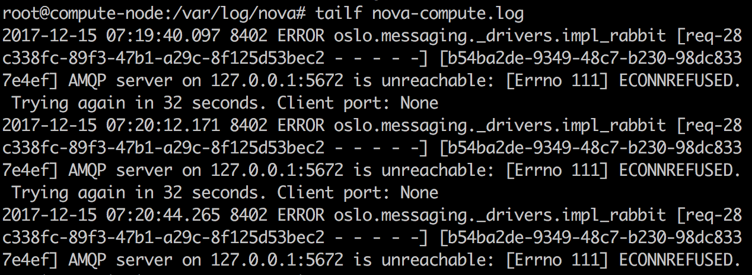
Troubleshooting
If nova-compute service fails to start, perform following actions
Goto -> /var/log/nova/
Check -> tailf nova-compute.log
On Compute node
On Controller node
# systemctl status rabbitmq-server.service -l
# rabbitmqctl status
# lsof -i :5672 |grep ‘compute_node_ip’

Slide 128
Deployment Roadmap
User
Controller node
HTTP Service
Compute node
Horizon
Glance
Nova
nova-compute
Neutron
Glance API
nova-api
Keystone
Libvirtd-driver
Cinder
Glance Registry
Nova-certi
Neutron
OpenVswitch
nova -scheduler
Cinder
Rabbit-MQ
nova -conductor
cinder-api
Native Hypervisor
Cinder-
backup
nova -consoleauth
Cinder- scheduler
nova -proxy
Connectivity
Cinder-
volumn
Service
Node
Storage
Component
Notes:
Connectivity

Slide 129
Networking Service : “Neutron”
Provide “Network as a Service”
Tenant isolation
Isolate private network between tenants with VLAN, VXLAN, GRE
NAPT, Floating IP(Static NAT)
NAPT: Private network to external network
Static NAT: external network to floating IP
DHCP, DNS
Load Balancing (LBaaS), VPNaaS
Notes:
Openstack-glance-api : interacts with storage back ends to handle requests for the image retrival and storage.
It uses openstack-glance registry to retrive image information
Openstack-glance registry : Manages all matadata for eac image (size, type)

Slide 130
Components in Neutron :
neutron-server: API Server
neutron-dhcp-agent: Provide DHCP for tenant network
neutron-plugin-linuxbridge-agent
Deploy L2 tenant network by using OVS
neutron-metadata-agent
Transfer metadata (SSH key, etc)
Publish http://169.254.169.254/
neutron-l3-agent
Provide L3 forwarding, NAT for accessing to external network from tenant network

Slide 131
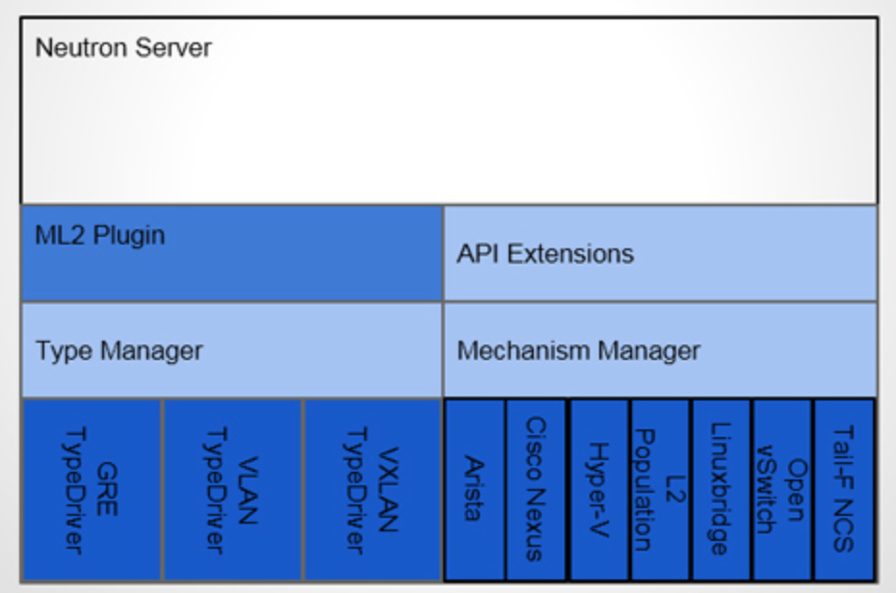
Neutron Modular Layer 2
http://www.atmarkit.co.jp/ait/articles/1504/08/news007_2.html

Slide 132
Neutron Modular Layer 2
Neutron Provide several plugins called Modular Layer 2 (ML2)
Categorized the following drivers
Type Driver
Flat, VLAN, VXLAN, GRE...
Mechanism Driver
Arista, Cisco Nexus, Linux Bridge, Openvswitch..
After passed API Request to Neutron Server, it is handled in ML2 Plugin

Slide 133
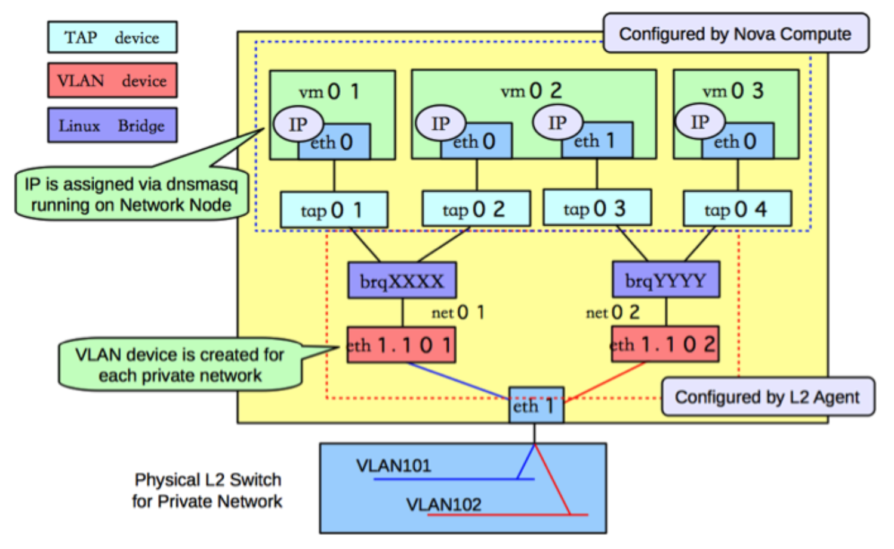
Linux Bridge Agent
https://access.redhat.com/documentation/en-US/Red_Hat_Enterprise_Linux_OpenStack_Platform/5/html/Cloud_Administrator_Guide/section_networking-scenarios.html

Slide 134
(Hands-On) Installing Neutron
Install and configure Controller node
Click here to install and configure the Neutron service on Controller node
Install and configure Compute node
Click here to install and configure the Neutron service on Compute node
Verify operation: Click here to verify the operation
※ Please select network option 2 (Self-Service Network)
!
!

Slide 135
Horizon
Provide dashboard for users and administrators
Manage and show some information
Computing Resources, Networking, Storage, Security...
Various components are behind Horizon Dashboard
Horizon calls REST APIs of components
This component is not an essential component
There is also method that use CLI or directly call REST API

Slide 136
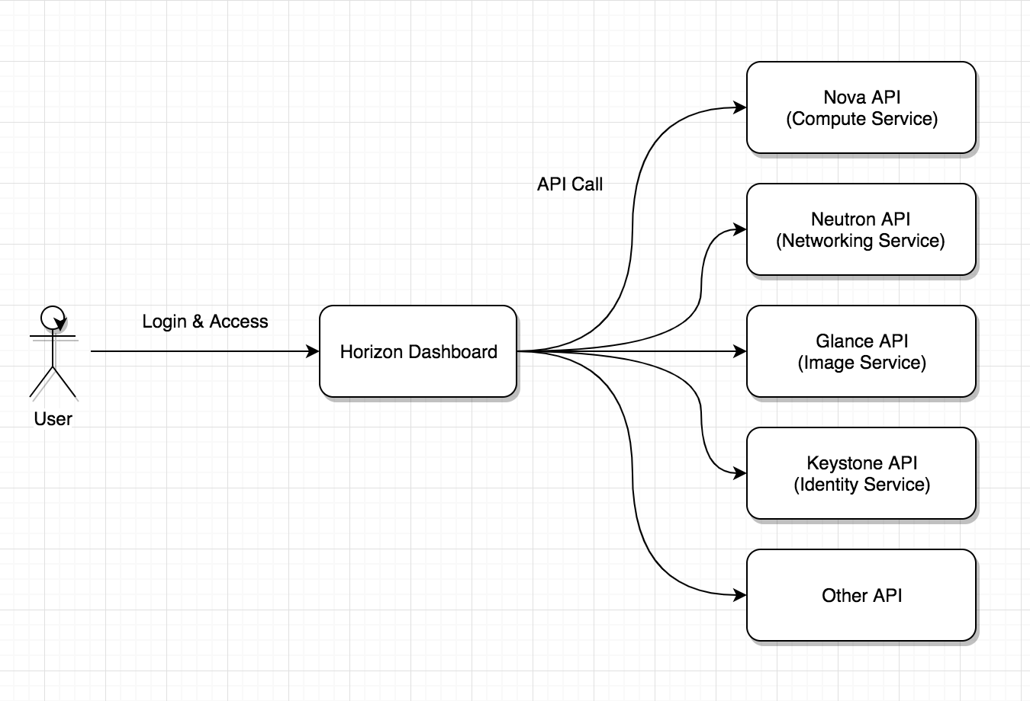
Horizon: Horizon calls REST APIs of components
Various components are behind Horizon

Slide 137
(Hands-On) Installing Horizon
Install and configure on Controller node
https://docs.openstack.org/ocata/install-guide-ubuntu/horizon-install.html#install-and-configure-components
Verify Operation
https://docs.openstack.org/ocata/install-guide-ubuntu/horizon-verify.html

Slide 138
Summary
What is cloud and its history?
Private, Public, Hybrid and Multi cloud
Different service model
Iaas, Paas, Faas, Saas
Openstack deployment tool
DevStack
OpenStack Component
Keystone, Glance, Nova, Neutron, Horizon
Hands on for building Openstack component

Slide 139
Notification
When today lecture finished Please answer the following questionnaire Day 2 : Click here to give your precious feedback
Notes:
questionnaire

